Slide 1
Introduction to JavaScript
IN712 Web3

Slide 2
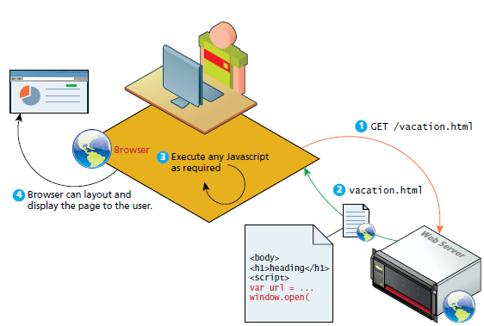
Client side scripting
Client side scripting refers to the client machine (the browser) running code locally rather than relying on the server to execute code and return the result
Notes:
Historical note about Client-side languages
Besides JavaScript, there are two other noteworthy client-side approaches to web programming
-Adobe Flash, vector based drawing and animation program, a video file format, and a software platform that has its own JavaScript-like programming language called ActionScript.
-Java applets.
An applet is a term that refers to a small application that performs a relatively small task.
Java applets are written using the Java programming language and are separate objects that are included within an HTML document via the <applet> tag, downloaded, and then passed on to a Java plug-in.
This plug-in then passes on the execution of the applet outside the browser to the Java Runtime Environment (JRE) that is installed on the client’s machine
With the universal adoption of JavaScript and HTML5, JavaScript remains the most dynamic and important client-side scripting language for the modern web developer

Slide 3
Advantages of Client side scripting
Processing can be offloaded from the server to client machines
Reducing the load on the server
The browser can respond more rapidly to user events than a request to a remote server ever could
This improves user experience
JavaScript can interact with the downloaded HTML in a way that the server cannot
This creates a user experience more like desktop software than simple HTML ever could

Slide 4
Disadvantages of Client side scripting
There is no warranty that the client has JavaScript enabled
Any required functionality should be housed on the server, despite the possibility that it could be offloaded to the client
The variety of browsers and operating systems make it difficult to test for all potential client configurations
What works in one browser, may generate an error in another
JavaScript heavy web applications can be complicated to read and maintain
In line JavaScript (embed in HTML) has the distinct disadvantage of blending HTML and JavaScript together, which decreases code readability and increases the difficulty of web development

Slide 5
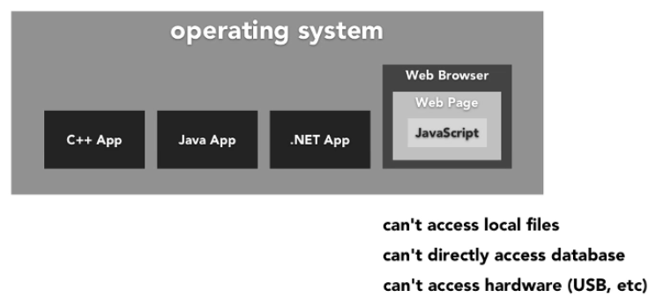
Javascript is a distinct programming language
Notes:
Running programs downloaded from the Internet is potentially dangerous.
You do not know much about the people behind most sites you
visit, and they do not necessarily mean well. Running programs by people
who do not mean well is how you get your computer infected by
viruses, your data stolen, and your accounts hacked.
Yet the attraction of the Web is that you can surf it without necessarily
trusting all the pages you visit. This is why browsers severely limit
the things a JavaScript program may do: it can’t look at the files on
your computer or modify anything not related to the web page it was
embedded in.
Isolating a programming environment in this way is called sandboxing,
the idea being that the program is harmlessly playing in a sandbox. But
you should imagine this particular kind of sandbox as having a cage of
thick steel bars over it, which makes it somewhat different from your
typical playground sandbox.
The hard part of sandboxing is allowing the programs enough room
to be useful yet at the same time restricting them from doing anything
dangerous. Lots of useful functionality, such as communicating with
other servers or reading the content of the copy-paste clipboard, can
also be used to do problematic, privacy-invading things.
Every now and then, someone comes up with a new way of doing something like that.

Slide 6
JavaScript: client-side scripting
Based on ECMAScript (ES) specification standard
Runs inside the browser
Object oriented:
almost everything in the language is an object
it doesn’t have classes per se, it has objects which encapsulate data properties and methods, and implement a form of inheritance
Dynamically typed:
not compiled, but parsed and interpreted at runtime
Variables can be easily converted from one data type to another
Functional: Functions are first class objects. You can have a variable that holds a function and you can pass it around as needed
JavaScript provides real-time in-browser access to all the elements of an html page, and allows us to add, remove and modify those elements, both content and format (via CSS) without contacting the server

Slide 7
JavaScript main usages
When designing software, it is often helpful to abstract the solution a little bit to help build a cognitive model in your mind that you can then implement
A common way of articulating such a cognitive model is via the term layer
In object-oriented programming, a software layer is a way of conceptually grouping programming classes that have similar functionality and dependencies
Presentation layer: focuses on the display of information
Changes in the HTML of a page which results in changes visible to the user
Validation layer: validate logical aspects of the user experience
Validating a form to make sure the email entered is valid
Asynchronous layers: route requests to server in the background
As certain events are triggered, the JavaScript sends the HTTP requests to the server, but while waiting for the response, the rest of the application functions normally, and the browser isn’t in a loading state
When response arrives JavaScript (perhaps) updates a portion of the page

Slide 8
Users without JavaScript
Too often website designers believe (erroneously) that users without JavaScript are somehow relics of a forgotten age
However, Users have a myriad of reasons for not using JavaScript
Web crawler: a client running on behalf of a search engine to download your side so that it can be indexed
These automated software agents tend to not interpret JavaScript
Browser plug-in: a piece of software that works within the browser that might interfere with JavaScript
Text based client
Widely deployed on Web servers which are often accessed using a command line interface
Visually disabled clients that use special browsing software to read the content of a webpage out loud

Slide 9
The <NoScript> Tag
We may want to make use of a simple mechanism to show users with no JavaScript special HTML content that will not be seen by those with JavaScript
That mechanism is the HTML tag <noscript>. Any text between the opening and closing tags will only be displayed to users without the ability to load JavaScript
This approach of adding functional replacements for those without JavaScript is also referred to as fail-safe design
Means that when a plan (such as displaying a fancy JavaScript popup calendar widget) fails (because for instance JavaScript is not enabled), then the system’s design will still work (for instance, by allowing the user to simply type in a date inside a text box)

Slide 10
Two approaches to web application design
Graceful degradation
Progressive enhancement

Slide 11
Graceful degradation
You develop your site for the abilities of current browsers
For those users who are not using current browsers, you might provide an alternate site or pages for those using older browsers that lack the JavaScript (or CSS or HTML5) used on the main site
The idea here is that the site is “degraded” (i.e., loses capability) “gracefully” (i.e., without pop-up JavaScript error codes or without condescending messages telling users to upgrade their browsers)

Slide 12
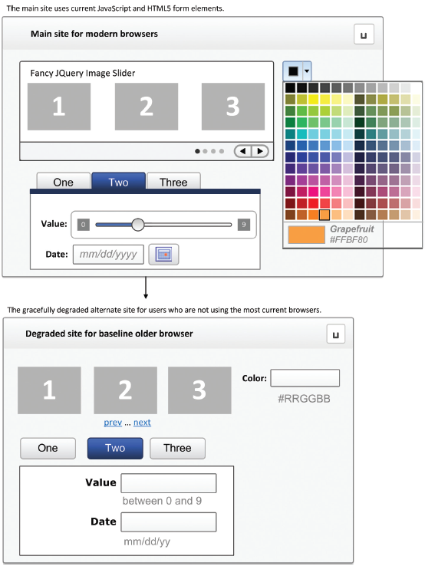
Example of graceful degradation

Slide 13
Progressive enhancement
Opposite approach
In this case, the developer creates the site using CSS, JavaScript, and HTML features that are supported by all browsers of a certain age or newer
To that baseline site, the developers can now progressively” (i.e., for each browser) “enhance” (i.e., add functionality) to their site based on the capabilities of the users’ browsers

Slide 14
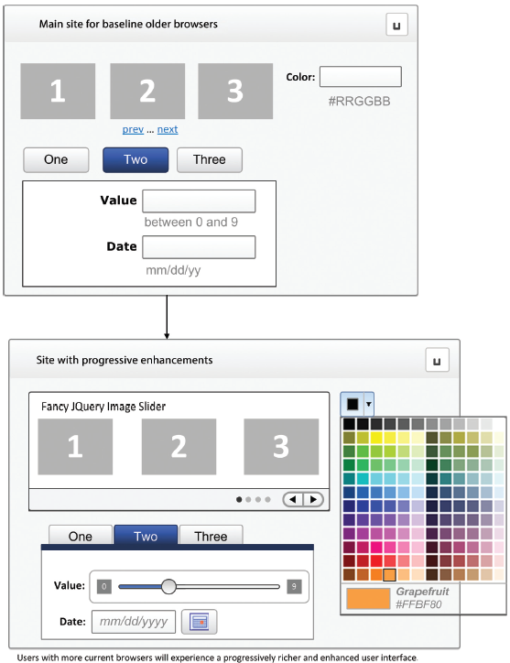
Example of Progressive Enhancements

Slide 15


Where to place JavaScript code
In-line JavaScript
Embedded JavaScript
External JavaScript

Slide 16
Basic Syntax
C-like
All operators, comparators and flow of control constructs are as for traditional C-family languages.
The scope of variables inside blocks is not supported
This means variables declared inside a loop may be accessible outside of the loop, counter to what one would expect
There is a === operator, which tests not only for equality but type equivalence
Null and undefined are two distinctly different states for a variable
Semicolons are not required, but are permitted (and encouraged)
There is no integer type, only number, which means floating-point rounding

Slide 17

Variables
Variables in JavaScript are dynamically typed, meaning a variable can be an integer, and then later a string, then later an object
This simplifies variable declarations, so that we do not require the familiar type fields like int, char, and String
This entails some risks
Instead, to declare a variable x, we use the var keyword, the name, and a semicolon
If we specify no value, then (being typeless) the default value is undefined

Slide 18
Variables
There are a couple types of variables that you may encounter as you’re learning JavaScript:
local variables: Local variables are defined within a function and can be used only within that function. Local variables are always prefaced using “ var ” when they’re defined
global variables: declared outside a function or inside a function using the window object
window.x=“Hi”
JavaScript’s primitive data types are
Number
String
Boolean
Undefined
Everything else is an object

Slide 19
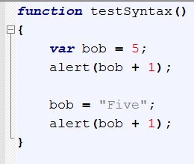
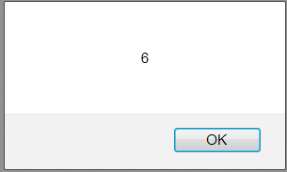
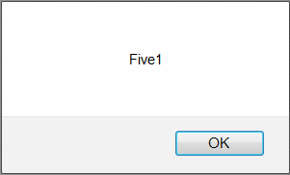
Type conversion
In this example we see how the interpretation of the + operator depends on the current data type of the variable
If bob is (holds) an int, + is addition. If bob is (holds) a string, + is concatenation.
Note that the function doesn’t have a return type either (we would use ‘void’ in C# or C++). That is typical of loosely-typed languages

Slide 20
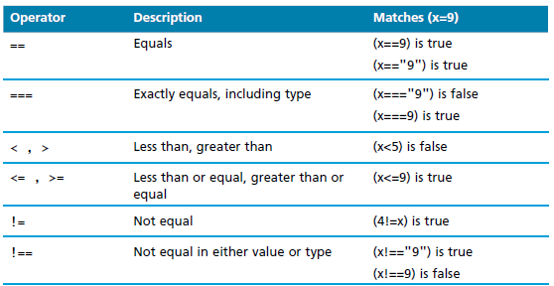
Comparison operators
Comparison operators help us to create Boolean statements that are either true or false
Operators familiar to those of you who have programmed in PHP, C#, or Java

Slide 21
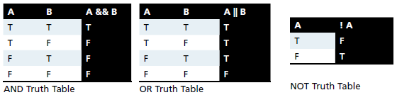
Logical operators
Used to combine logically several comparison operators
Build complicated expressions

Slide 22
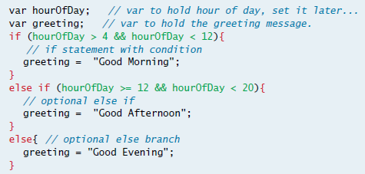
Conditional if statement
Syntax is almost identical to that of PHP, Java, or C
The condition to test is contained within ( ) brackets with the body contained in { } blocks.

Slide 23


Loops
Like conditionals, loops use the ( ) and { } blocks to define the condition and the body of the loop
The most basic loop is the while loop, which loops until the condition is not met.
Loops normally initialize a loop control variable before the loop, use it in the condition, and modify it within the loop.
A for loop combines the common components of a loop: initialization, condition, and post-loop operation into one statement.

Slide 24
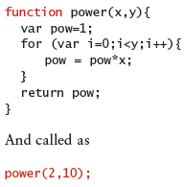
Functions
Functions are the building block for modular code in JavaScript
They are defined by using the reserved word function and then the function name and (optional) parameters
Since JavaScript is dynamically typed, functions do not require a return type, nor do the parameters require type

Slide 25


Anonymous Functions
I have declared a var called “functionHolder”. Naturally, it is untyped
I have also declared a function with one statement, the call to alert
This function has no name – just the keyword and the brackets
The function is therefore “anonymous”
The function is assigned to the variable
In C# and C++, we assign things to variables – ints, strings, class instances, arrays, etc. – but not functions. In those languages, functions are chunks of code, they are not things. But in JavaScript, functions are things, just like ints or class instances. You can think of them as little machines, if you like, that execute the code they contain

Slide 26
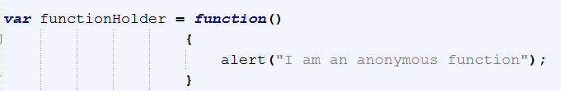
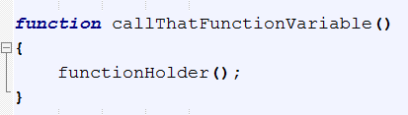
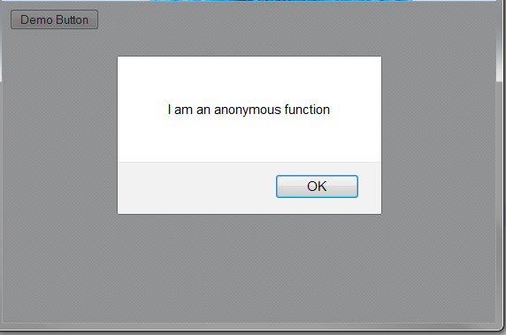
Functions
So once you have a function stuffed in a variable, what can you do with it? It’s a function, so naturally, you can call it
Let’s now write another function (a named one) and inside it, use the functionHolder variable to call that anonymous function it holds
There it is. functionHolder is a variable, like x or myName. We usually use variables in expressions or assign things to them and so forth
But since functionHolder is currently holding a function object, we can call it, just as though it was the name of a function

Slide 27
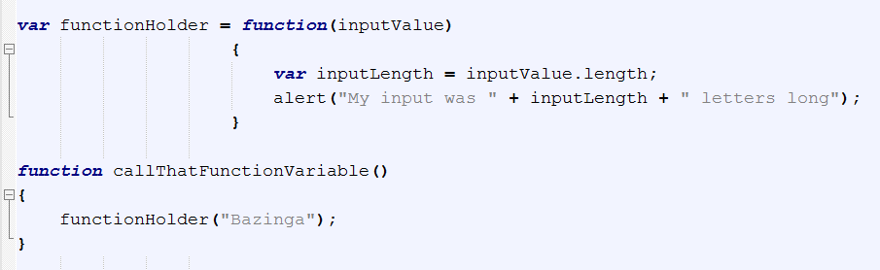
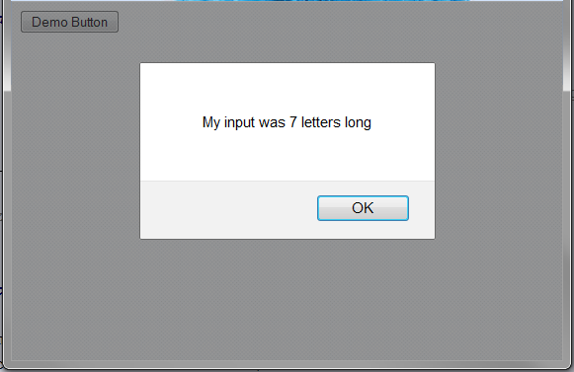
Functions – what happens here?

Slide 28
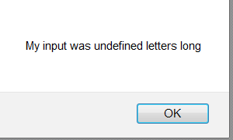
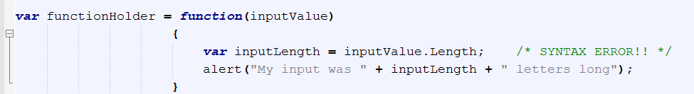
Problems of untyped languages
Let everything be the same except the length property access has changed to Length.
The variable inputLength is assigned the result of a failed property access (Length instead of length).
As far as JavaScript is concerned, that just means it wasn’t assigned a good value. So it is “undefined”. But that’s not a big deal to JavaScript, really, because it’s not terribly fussy about what you put in its variables.
What might we expect to happen?
One thing that won’t happen is a compilation error. Why not? (JavaScript is not compiled).
THIS IS A BIG PROBLEM with JavaScript. Typos are not caught. You have to hunt them down.

Slide 29
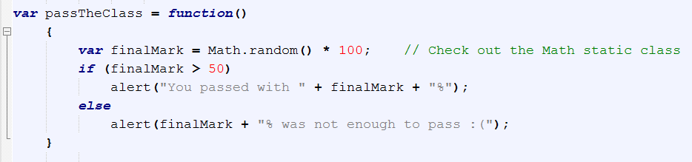
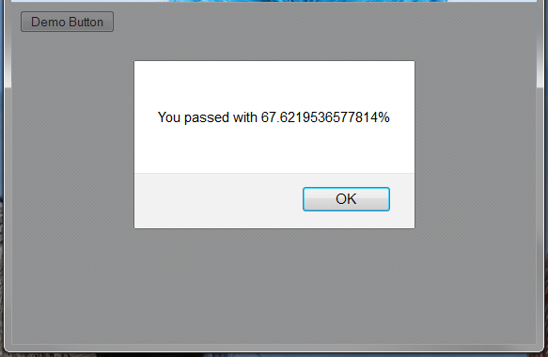
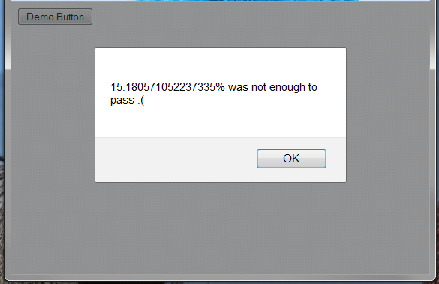
More Examples

Slide 30
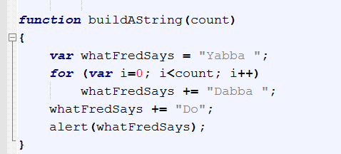
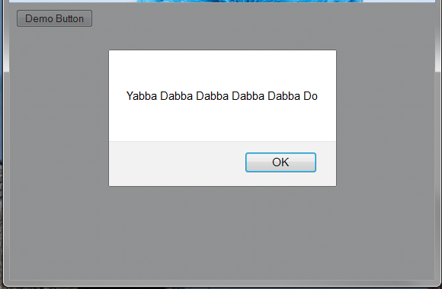
More Examples

Slide 31
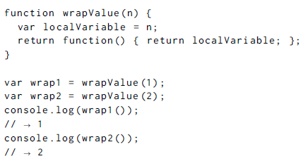
JavaScript closure
Being able to reference a specific instance of local variables in an enclosing function—is called closure

Slide 32
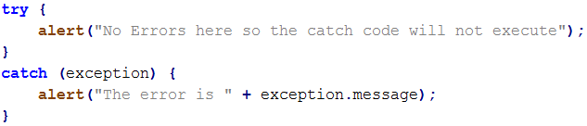
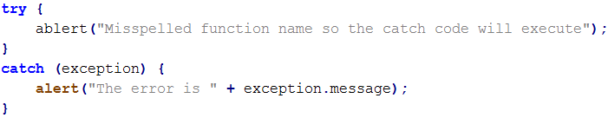
Errors Using Try and Catch
When the browser’s JavaScript engine encounters an error, it will throw an exception. These exceptions interrupt the regular, sequential execution of the program and can stop the JavaScript engine altogether.
You can optionally catch these errors preventing disruption of the program using the try–catch block

Slide 33
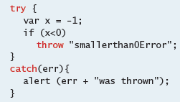

Throwing Your Own Exceptions
try-catch can be used exclusively to catch built-in JavaScript errors,
try-catch can also be used by your programs, to throw your own messages.
The throw keyword stops normal sequential execution, just like the built-in exceptions
any object can be thrown, although in practice a string usually suffices

Slide 34
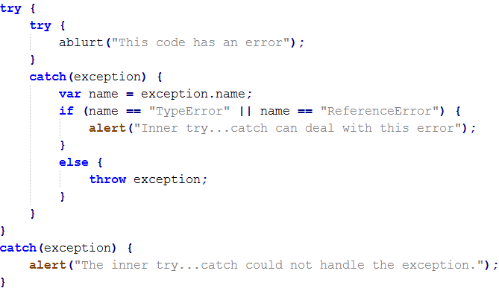
Nested try… catch Statements
The inner try statement contains a line of code that contains an error. The catch statement of the inner try...catch checks the value of the error’s name to see if the exception’s name is either TypeError or ReferenceError, and deal with it
If the error caught by the inner catch statement is any other type of error, it is thrown up again for the catch statement of the outer try...catch to deal with.

Slide 35
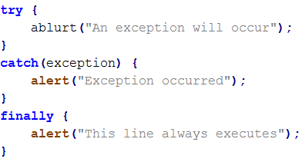
Finally Clauses
The try...catch statement has a finally clause that defines a block of code that always executes even if an exception wasn’t thrown.
The finally clause can’t appear on its own; it must be after a try block
The finally part is a good place to put any cleanup code that needs to execute regardless of exceptions that previously occurred.

Slide 36
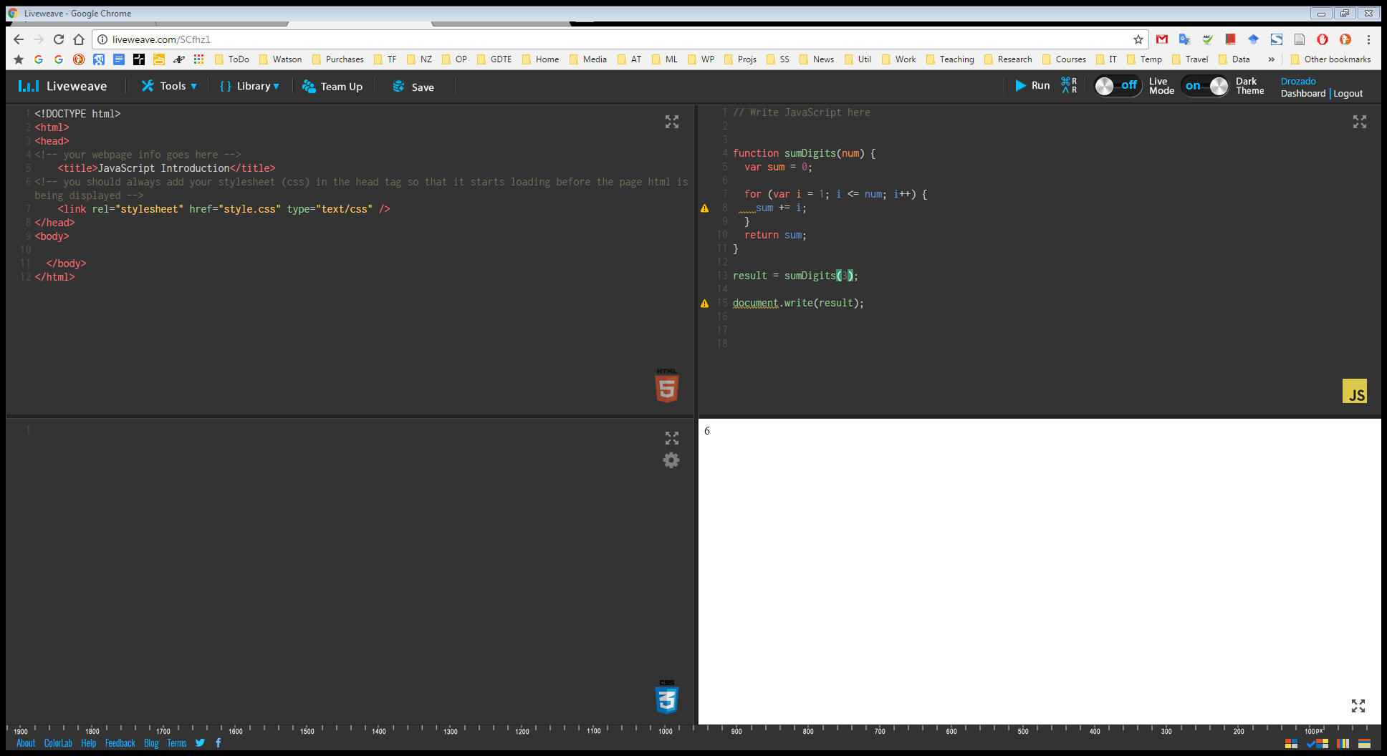
Demo

Slide 37
References
Fundamentals of Web Development
Beginning JavaScript
Eloquent JavaScript

